Slide 1
ns-3 Training

Slide 2
Example walkthrough
This section progressively builds up a simple ns-3 example, explaining concepts along the way
Files for these programs are available on the ns-3 wiki

Slide 3
Example program
wns3-version1.cc
Link found on wiki page
Place program in scratch/ folder

Slide 4
Fundamentals
Key objects in the simulator are Nodes, Packets, and Channels
Nodes contain Applications, “stacks”, and NetDevices

Slide 5
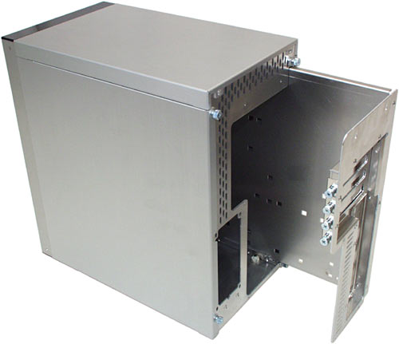


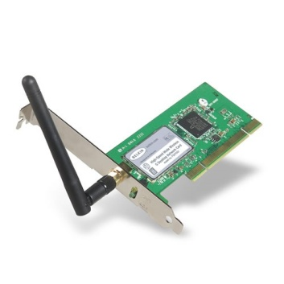
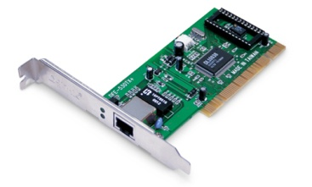
Node basics
A Node is a shell of a computer to which applications, stacks, and NICs are added
Application
Application
Application
“DTN”

Slide 6
NetDevices and Channels
NetDevices are strongly bound to Channels of a matching type
ns-3 Spectrum models relax this assumption
Nodes are architected for multiple interfaces
WifiChannel
WifiNetDevice

Slide 7
Internet Stack
Internet Stack
Provides IPv4 and some IPv6 models currently
No non-IP stacks ns-3 existed until 802.15.4 was introduced in ns-3.20
but no dependency on IP in the devices, Node object, Packet object, etc. (partly due to the object aggregation system)

Slide 8
Other basic models in ns-3
Devices
WiFi, WiMAX, CSMA, Point-to-point, ...
Error models and queues
Applications
echo servers, traffic generator
Mobility models
Packet routing
OLSR, AODV, DSR, DSDV, Static, Nix-Vector, Global (link state)

Slide 9
Structure of an ns-3 program
int main (int argc, char *argv[])
{
// Set default attribute values
// Parse command-line arguments
// Configure the topology; nodes, channels, devices, mobility
// Add (Internet) stack to nodes
// Configure IP addressing and routing
// Add and configure applications
// Configure tracing
// Run simulation
}

Slide 10
Helper API
The ns-3 “helper API” provides a set of classes and methods that make common operations easier than using the low-level API
Consists of:
container objects
helper classes
The helper API is implemented using the low-level API
Users are encouraged to contribute or propose improvements to the ns-3 helper API

Slide 11
Containers
Containers are part of the ns-3 “helper API”
Containers group similar objects, for convenience
They are often implemented using C++ std containers
Container objects also are intended to provide more basic (typical) API

Slide 12
The Helper API (vs. low-level API)
Is not generic
Does not try to allow code reuse
Provides simple 'syntactical sugar' to make simulation scripts look nicer and easier to read for network researchers
Each function applies a single operation on a ''set of same objects”
A typical operation is "Install()"

Slide 13
Helper Objects
NodeContainer: vector of Ptr<Node>
NetDeviceContainer: vector of Ptr<NetDevice>
InternetStackHelper
WifiHelper
MobilityHelper
OlsrHelper
... Each model provides a helper class

Slide 14
Installation onto containers
Installing models into containers, and handling containers, is a key API theme
NodeContainer c;
c.Create (numNodes);
...
mobility.Install (c);
...
internet.Install (c);
...

Slide 15
Native IP models
IPv4 stack with ARP, ICMP, UDP, and TCP
IPv6 with ND, ICMPv6, IPv6 extension headers, TCP, UDP
IPv4 routing: RIPv2, static, global, NixVector, OLSR, AODV, DSR, DSDV
IPv6 routing: RIPng, static

Slide 16
IP address configuration
An Ipv4 (or Ipv6) address helper can assign addresses to devices in a NetDevice container
Ipv4AddressHelper ipv4;
ipv4.SetBase ("10.1.1.0", "255.255.255.0");
csmaInterfaces = ipv4.Assign (csmaDevices);
...
ipv4.NewNetwork (); // bumps network to 10.1.2.0
otherCsmaInterfaces = ipv4.Assign (otherCsmaDevices);

Slide 17
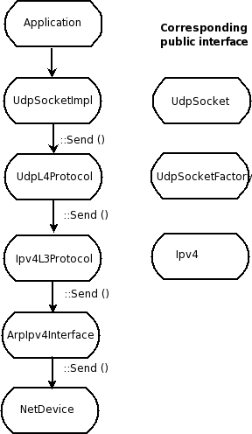
Internet stack
The public interface of
the Internet stack is
defined (abstract base
classes) in
src/network/model
directory
The intent is to support
multiple implementations
The default ns-3 Internet
stack is implemented in
src/internet-stack

Slide 18
ns-3 TCP
Four options exist:
native ns-3 TCP
TCP simulation cradle (NSC)
Direct code execution (Linux/FreeBSD library)
Use of virtual machines
To enable NSC:
internetStack.SetNscStack ("liblinux2.6.26.so");

Slide 19
Native TCP models
TCP NewReno is baseline
TCP SACK under review for ns-3.26
TCP congestion control recently refactored, and many TCP variants are under finalization
Present: BIC, Highspeed, Hybla, Illinois, Scalable, Vegas, Veno, Westwood, YeAH
Pending: CUBIC, H-TCP, SACK
MP-TCP is under development from past summer project (for ns-3.27?)

Slide 20
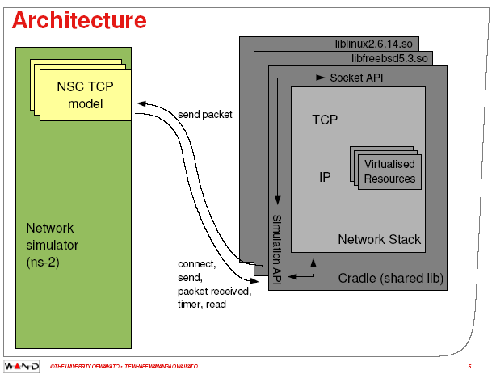
ns-3 simulation cradle
Port by Florian Westphal of Sam Jansen’s Ph.D. work
Figure reference: S. Jansen, Performance, validation and testing with the Network
Simulation Cradle. MASCOTS 2006.

Slide 21
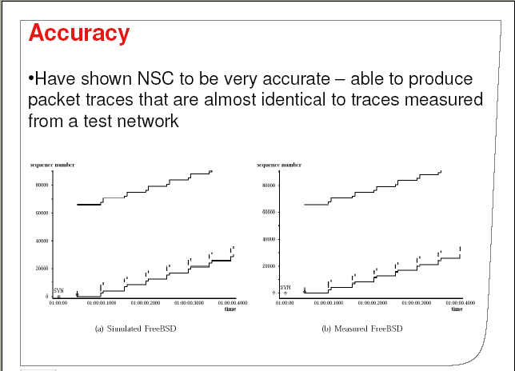
ns-3 simulation cradle
For ns-3:
Linux 2.6.18
Linux 2.6.26
Linux 2.6.28
Others:
FreeBSD 5
lwip 1.3
OpenBSD 3
Other simulators:
ns-2
OmNET++
Figure reference: S. Jansen, Performance, validation and testing with the Network
Simulation Cradle. MASCOTS 2006.

Slide 22
Review of sample program (cont.)
ApplicationContainer apps;
OnOffHelper onoff ("ns3::UdpSocketFactory",
InetSocketAddress ("10.1.2.2", 1025));
onoff.SetAttribute ("OnTime", StringValue ("Constant:1.0"));
onoff.SetAttribute ("OffTime", StringValue ("Constant:0.0"));
apps = onoff.Install (csmaNodes.Get (0));
apps.Start (Seconds (1.0));
apps.Stop (Seconds (4.0));
PacketSinkHelper sink ("ns3::UdpSocketFactory",
InetSocketAddress ("10.1.2.2", 1025));
apps = sink.Install (wifiNodes.Get (1));
apps.Start (Seconds (0.0));
apps.Stop (Seconds (4.0));
Traffic generator
Traffic receiver

Slide 23
Applications and sockets
In general, applications in ns-3 derive from the ns3::Application base class
A list of applications is stored in the ns3::Node
Applications are like processes
Applications make use of a sockets-like API
Application::Start () may call ns3::Socket::SendMsg() at a lower layer

Slide 24
Sockets API
Plain C sockets
int sk;
sk = socket(PF_INET, SOCK_DGRAM, 0);
struct sockaddr_in src;
inet_pton(AF_INET,”0.0.0.0”,&src.sin_addr);
src.sin_port = htons(80);
bind(sk, (struct sockaddr *) &src, sizeof(src));
struct sockaddr_in dest;
inet_pton(AF_INET,”10.0.0.1”,&dest.sin_addr);
dest.sin_port = htons(80);
sendto(sk, ”hello”, 6, 0, (struct sockaddr *) &dest, sizeof(dest));
char buf[6];
recv(sk, buf, 6, 0);
}
ns-3 sockets
Ptr<Socket> sk =
udpFactory->CreateSocket ();
sk->Bind (InetSocketAddress (80));
sk->SendTo (InetSocketAddress (Ipv4Address (”10.0.0.1”), 80), Create<Packet> (”hello”, 6));
sk->SetReceiveCallback (MakeCallback (MySocketReceive));
[…] (Simulator::Run ())
void MySocketReceive (Ptr<Socket> sk, Ptr<Packet> packet)
{
...
}

Slide 25
New in ns-3.25: traffic control
Patterned after Linux traffic control, allows insertion of software-based priority queues between the IP layer and device layer
pfifo_fast, RED, Adaptive RED, CoDel
planned for ns-3.26: FQ-CoDel, PIE, Byte Queue Limits (BQL)

Slide 26
NetDevice trace hooks
Example: CsmaNetDevice
NetDevice::
ReceiveCallback
CsmaNetDevice::Send ()
MacTx
MacRx
MacDrop
queue
Sniffer
PromiscSniffer
MacTxBackoff
PhyTxBegin
PhyRxEnd
PhyRxDrop
PhyTxDrop
PhyTxEnd
CsmaNetDevice::
TransmitStart()
CsmaNetDevice::
Receive()
CsmaChannel

Slide 27
Nodes, Mobility, and Position
ALL nodes have to be created before simulation starts
Position Allocators setup initial position of nodes
List, Grid, Random position…
Mobility models specify how nodes will move
Constant position, constant velocity/acceleration, waypoint…
Trace-file based from mobility tools such as SUMO, BonnMotion (using NS2 format)
Routes Mobility using Google API (*)
(*) Presented in WNS3 - 2015

Slide 28
Position Allocation Examples
List MobilityHelper mobility; // place two nodes at specific positions (100,0) and (0,100) Ptr<ListPositionAllocator> positionAlloc = CreateObject<ListPositionAllocator> (); positionAlloc->Add (Vector (100, 0, 0)); positionAlloc->Add (Vector (0, 100, 0)); mobility.SetPositionAllocator(positionAlloc);
Grid Position
MobilityHelper mobility;
// setup the grid itself: nodes are laid out started from (-100,-100) with 20 per row, the x
// interval between each object is 5 meters and the y interval between each object is 20 meters
mobility.SetPositionAllocator ("ns3::GridPositionAllocator",
"MinX", DoubleValue (-100.0),
"MinY", DoubleValue (-100.0),
"DeltaX", DoubleValue (5.0),
"DeltaY", DoubleValue (20.0),
"GridWidth", UintegerValue (20),
"LayoutType", StringValue ("RowFirst"));
Random Rectangle Position
// place nodes uniformly on a straight line from (0, 1000)
MobilityHelper mobility;
Ptr<RandomRectanglePositionAllocator> positionAloc = CreateObject<RandomRectanglePositionAllocator>();
positionAloc->SetAttribute("X", StringValue("ns3::UniformRandomVariable[Min=0.0|Max=100.0]"));
positionAloc->SetAttribute("Y", StringValue("ns3::ConstantRandomVariable[Constant=50.0]"));
mobility.SetPositionAllocator(positionAloc);

Slide 29
Mobility Model Example
Constant Position
MobilityHelper mobility;
mobility.SetMobilityModel ("ns3::ConstantPositionMobilityModel");
mobility.Install (nodes);
Constant Speed
MobilityHelper mobility;
mobility.SetMobilityModel ("ns3::ConstantVelocityMobilityModel");
mobility.Install (nodes);
Ptr<UniformRandomVariable> rvar = CreateObject<UniformRandomVariable>();
for (NodeContainer::Iterator i = nodes.Begin (); i != nodes.End (); ++i){
Ptr<Node> node = (*i);
double speed = rvar->GetValue(15, 25);
node->GetObject<ConstantVelocityMobilityModel>()->SetVelocity(Vector(speed,0,0));
}
Trace-file based
std::string traceFile = “mobility_trace.txt”;
// Create Ns2MobilityHelper with the specified trace log file as parameter
Ns2MobilityHelper ns2 = Ns2MobilityHelper (traceFile);
ns2.Install (); // configure movements for each node, while reading trace file
Notes:
Explain key differences of these models and under what situations would I use each one.

Slide 30
Interesting ns-3 extensions
ns-3-highway-mobility (https://code.google.com/p/ns-3-highway-mobility/)
Implement IDM and MOBIL change lane, highway class, traffic-lights.
Based on ns-3.8
No longer maintained
Virtual Traffic Lights (PROMELA) (https://dsn.tm.kit.edu/misc_3434.php)
Manhattan IDM mobility model
NLOS propagation loss models
(Virtual) Traffic Light applications

Slide 31
Propagation Models
Propagation Loss
ITUR1411, LogDistance, ThreeLogDistance, Range, TwoRayGround, Friis
Nakagami, Jakes
Obstacle model (*)
Propagation Delay
Constant Speed
Random
Be careful when using YansWifiChannelHelper::Default() the LogDistance propagation model is added. Calling AddPropagationLoss() again will add a second propagation loss model.
(*) Presented in WNS3 2015

Slide 32
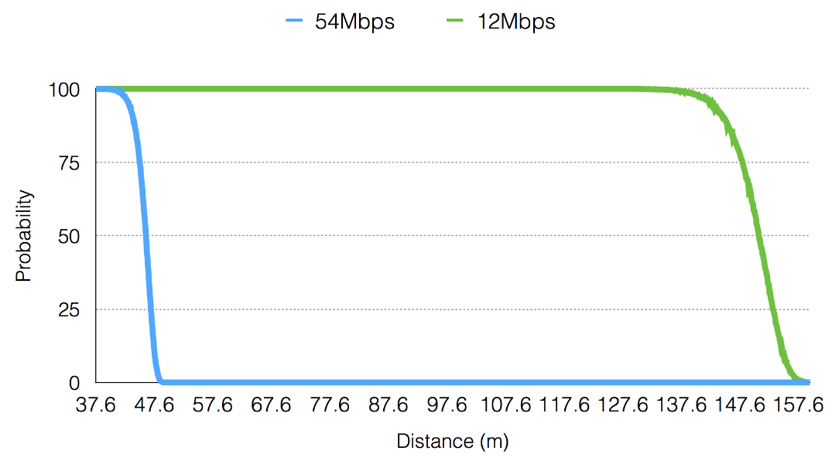
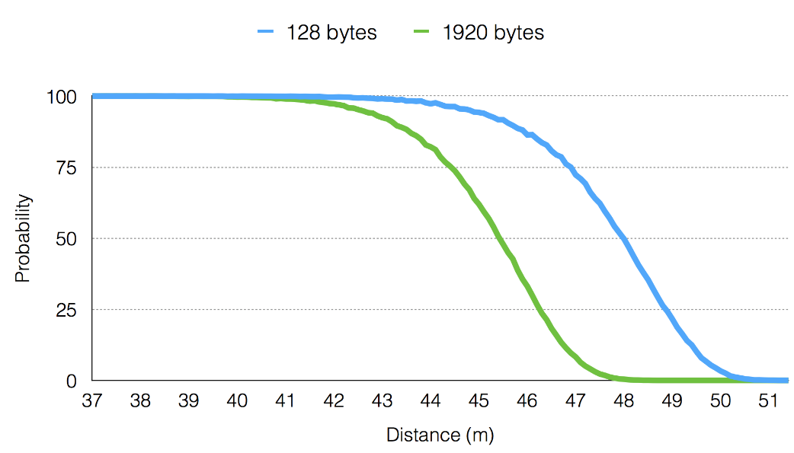
Communication Range
Depends on many factors
Propagation loss model and PHY configuration
Frame size (big vs small)
Transmission mode (6Mbps vs 54 Mbps)

Slide 33
Example program iterations
Walk through four additional revisions of the example program
wns3-version2.cc
wns3-version3.cc
wns3-version4.cc

